Slide 1
SCS1302 Internet Programming
Unit 2 JavaScript
Ms.J.S.Vimali

Slide 2
The substr() Method
substr() is similar to slice().
The difference is that the second parameter specifies the length of the extracted part.
<!DOCTYPE html>
<html>
<body>
<h2>JavaScript String Methods</h2>
<p>The substr() method extract a part of a string
and returns the extracted parts in a new string:</p>
<p id="demo"></p>
<script>
var str = "Apple, Banana, Kiwi";
var res = str.substr(7,6);
document.getElementById("demo").innerHTML = res;
</script>
</body>
</html>

Slide 3
If you omit the second parameter, substr() will slice out the rest of the string.
var str = "Apple, Banana, Kiwi";
var res = str.substr(7);
document.getElementById("demo").innerHTML = res;
Banana, Kiwi
If the first parameter is negative, the position counts from the end of the string.
var str = "Apple, Banana, Kiwi";
var res = str.substr(-4);
Kiwi

Slide 4
Output

Slide 5
Replacing String Content
The replace() method replaces a specified value with another value in a string:
<!DOCTYPE html>
<html>
<body>
<h2>JavaScript String Methods</h2>
<p>Replace “Internet" with “Python" in the paragraph below:</p>
<button onclick="myFunction()">Try it</button>
<p id="demo">Internet Programming</p>
<script>
function myFunction() {
var str = document.getElementById("demo").innerHTML;
var txt = str.replace(" Internet "," Python ");
document.getElementById("demo").innerHTML = txt;
}
</script>
</body>
</html>

Slide 6
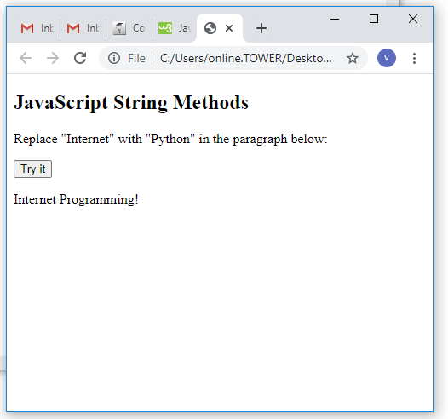
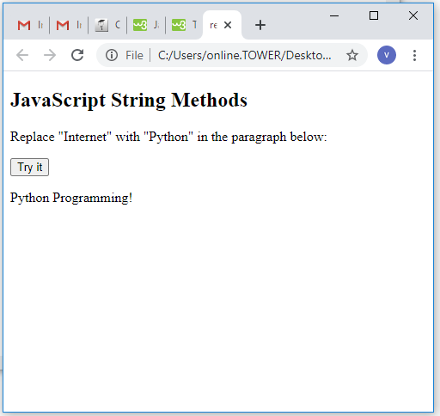
Output

Slide 7
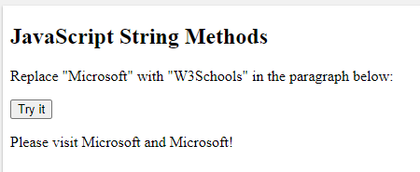
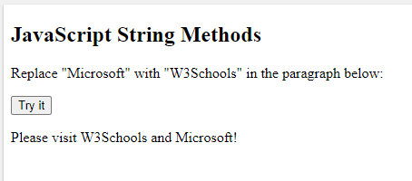
Output
The replace() method does not change the string it is called on. It returns a new string.
By default, the replace() method replaces only the first match:
str = "Please visit Microsoft and Microsoft!"; var n = str.replace("Microsoft", "W3Schools");

Slide 8
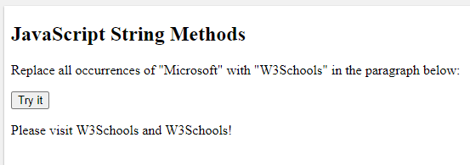
Output
To replace case insensitive, use a regular expression with an /i flag (insensitive)
To replace all matches, use a regular expression with a /g flag (global match)
str = "Please visit Microsoft and Microsoft!"; var n = str.replace(/Microsoft/g, "W3Schools");

Slide 9
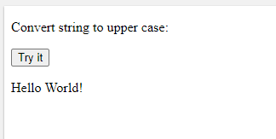
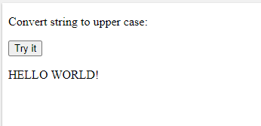
Output
Converting to Upper and Lower Case
A string is converted to upper case with toUpperCase():
Example
var text1 = "Hello World!"; // String
var text2 = text1.toUpperCase(); // text2 is text1 converted to upper

Slide 10
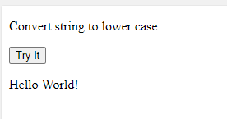
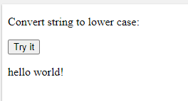
Output
A string is converted to lower case with toLowerCase()
var text1 = "Hello World!"; // String var text2 = text1.toLowerCase(); // text2 is text1 converted to lower

Slide 11
The concat() Method
concat() joins two or more strings
var text1 = "Hello"; var text2 = "World"; var text3 = text1.concat(" ", text2);
String.trim()
The trim() method removes whitespace from both sides of a string
Example
var str = " Hello World! "; alert(str.trim());

Slide 12
Extracting String Characters
There are 3 methods for extracting string characters:
charAt(position)
charCodeAt(position)
Property access [ ]
The charAt() Method
The charAt() method returns the character at a specified index (position) in a string:
var str = "HELLO WORLD";
str.charAt(0); // returns H
The charCodeAt() Method
The charCodeAt() method returns the unicode of the character at a specified index in a string:
The method returns a UTF-16 code (an integer between 0 and 65535).
var str = "HELLO WORLD";
str.charCodeAt(0); // returns 72

Slide 13
Converting a String to an Array A string can be converted to an array with the split() method:
var txt = "a,b,c,d,e"; // String txt.split(","); // Split on commas txt.split(" "); // Split on spaces txt.split("|"); // Split on pipe
If the separator is omitted, the returned array will contain the whole string in index [0].
If the separator is "", the returned array will be an array of single characters:

Slide 14
Find the position of the character h in the string
txt.var txt = "abcdefghijklm";
var pos = txt. _____________;

Slide 15
Adding Numbers and Strings
If you add two strings, the result will be a string concatenation:
Example
var x = "10"; var y = "20"; var z = x + y; // z will be 1020 (a string)
A common mistake is to expect this result to be 30:
var x = 10; var y = 20; var z = "The result is: " + x + y;

Slide 16
A common mistake is to expect this result to be 102030:
var x = 10; var y = 20; var z = "30"; var result = x + y + z;
var x = "100"; var y = "10"; var z = x / y; // z will be 10
var x = "100"; var y = "10"; var z = x * y; // z will be 1000

Slide 17
var x = "100"; var y = "10"; var z = x - y; // z will be 90
NaN - Not a Number
NaN is a JavaScript reserved word indicating that a number is not a legal number.
Trying to do arithmetic with a non-numeric string will result in NaN (Not a Number):
Example
var x = 100 / "Apple"; // x will be NaN (Not a Number)

Slide 18
You can use the global JavaScript function isNaN() to find out if a value is a number:
Example
var x = 100 / "Apple"; isNaN(x); // returns true because x is Not a Number
Watch out for NaN. If you use NaN in a mathematical operation, the result will also be NaN:
Example
var x = NaN; var y = 5; var z = x + y; // z will be NaN

Slide 19
var x = 2 / 0; // x will be Infinity var y = -2 / 0; // y will be –Infinity
Hexadecimal
JavaScript interprets numeric constants as hexadecimal if they are preceded by 0x.
Example
var x = 0xFF; // x will be 255

Slide 20
Numbers Can be Objects
Normally JavaScript numbers are primitive values created from literals:
var x = 123;
But numbers can also be defined as objects with the keyword new:
var y = new Number(123);
Example
var x = 123;
var y = new Number(123); // typeof x returns number // typeof y returns object
var x = 500;
var y = new Number(500); // (x === y) is false because x and y have different types

